Slide 1

Guess the word game
A Comprehensive Analysis of Logic, Architecture, and Challenges in C Programming

Slide 2






Core Modules
Initialization
Logic Engine
Termination
Allocates memory, loads the dictionary from a file, and uses srand() to select a random target word for the session.
The main loop handles user input via stdin, compares characters against the target array, and updates the masked string.
Determines win/loss conditions based on lives counter or string completion, then triggers memory cleanup via free().

Slide 3
Execution Flow
Start
Input
Process
End
Load Word Bank
Read Char
Validate & Update
Result & Cleanup

Slide 4
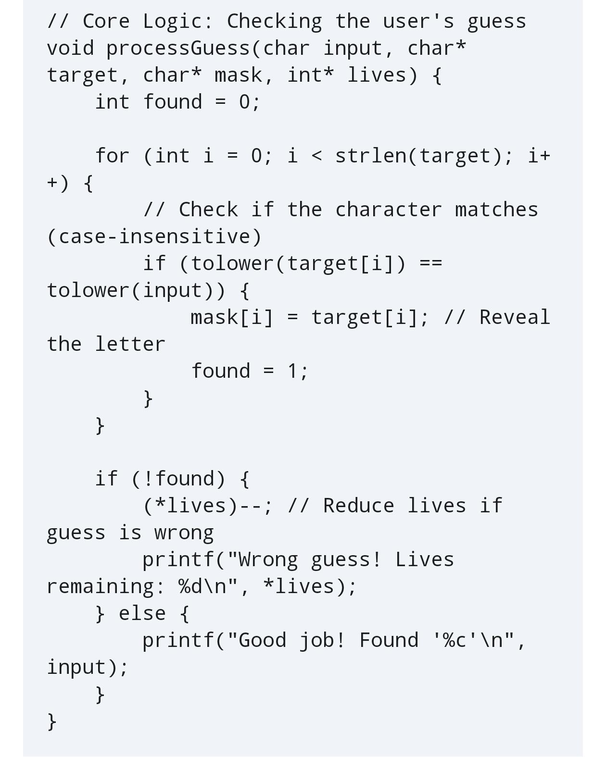
String Logic
Pointer Manipulation
At the heart of the game is efficient string handling. The project utilizes character pointers to traverse arrays without the overhead of copying data.
Memory Management
Dynamic memory allocation is used to handle word lists of varying sizes, ensuring the program is memory efficient regardless of dictionary size.

Slide 5



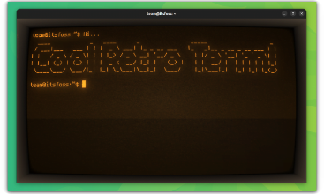
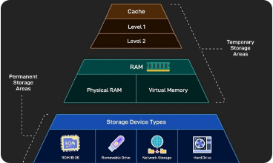
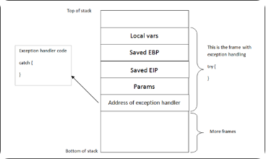
Key Technical Drawbacks
UI Limitations
Memory Leaks
Buffer Overflow
Lack of native graphics leads to a purely text-based experience, which is less engaging for modern users.
Manual management requires strict free() calls; missing one causes leaks over long sessions.
Using functions like gets() can allow input to exceed array bounds, posing security risks.

Slide 6

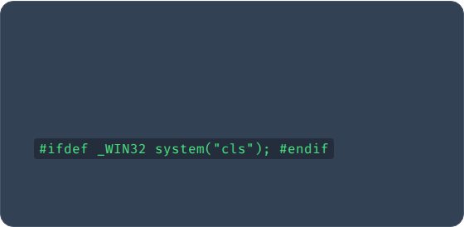
Enhancing the Experience
Visual Upgrades
Platform Independence
To overcome UI limitations, we implement ANSI Escape Codes to add color to the terminal output (e.g., Red for errors, Green for success). For a GUI-like feel, the ncurses library can be integrated.
System calls like cls vs clear break portability. We solve this using preprocessor directives:

Slide 7
Robust Coding Practices
Input Sanitization: Replace gets() with fgets() to strictly limit input length and prevent buffer overflows.
Memory Cleanup: Implement a dedicated cleanup() function that runs at the end of the main() loop to free all allocated pointers.
Debugging Tools: Utilize tools like Valgrind during the development phase to automatically detect and report memory leaks.
Modular Design: Separate logic into distinct functions to improve readability and make debugging specific modules easier.

Slide 8
Thank You!

